Slide 1
Kubernetes Workshop: Develop and Deploy a Microservices Application on Kubernetes
Dell Technologies Educations Services

Slide 2
Workshop Agenda
DAY 3
Building a microservice application
Implementing service discovery on Kubernetes for microservice application
Expose your service with Loadbalancer
Continuously deploy microservice application with pipeline

Slide 4
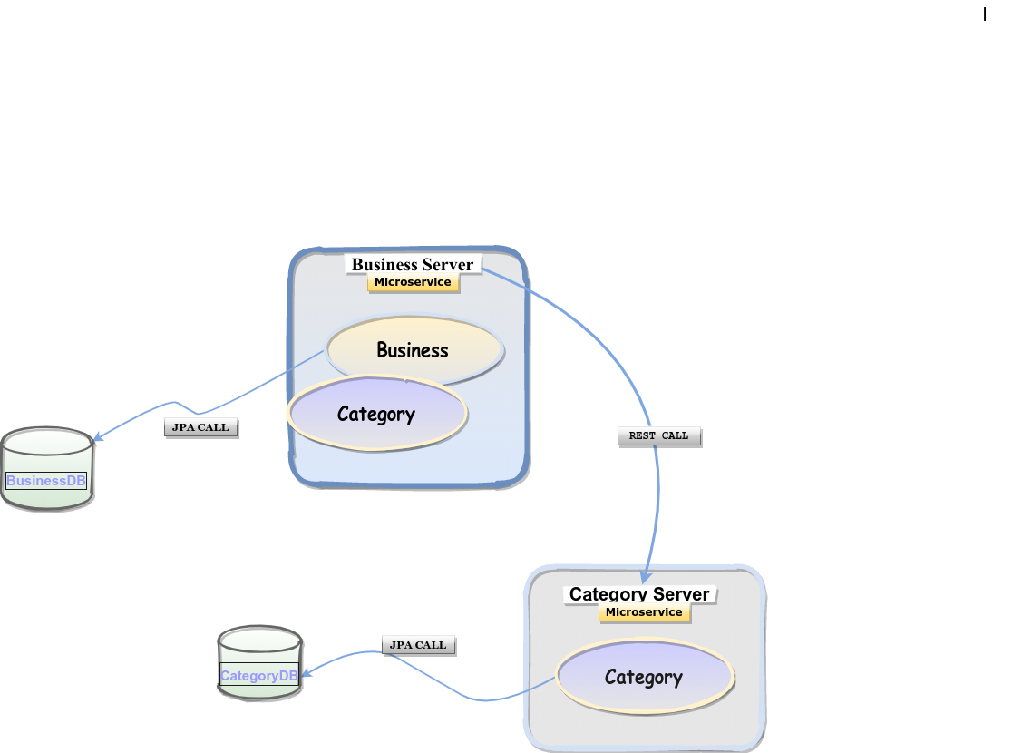
Building a Microservice Application on Kubernetes
Introduction to the use case :

Slide 5
Challenges of Microservices
Data consistency
Complex Configurations
Service Registration and Discovery
Routing the traffic
Load balancing
Fault Tolerance
Monitoring and Tracing

Slide 6
Service Discovery in Kubernetes

Slide 7
Quick Recap – Pods and Replication Controllers
Pods are fundamental units of deployment
Each Pod has one or more containers that may expose ports
Each Pod has a routable IP address assigned to it
Labels are used to logically identify Pods that match a specific criterion
Replication Controller’s Selector matches the Pods based on Labels
Replication Controller maintains the desired count of Pods all the time
Pod IP address may change during its lifetime

Slide 8
Quick Recap – Kubernetes Service
A Service in Kubernetes is an object, similar to a Pod
A service can be defined as a logical set of pods
It acts as the intermediary for Pods to talk to each other
Selectors are used for accessing all the Pods that match a specific Label
Each Service exposes one of more ports and targetPorts
The targetPort is mapped to the port exposed by matching Pods
Pod IP address may change during its lifetime
Important features provided by Service:
Load Balancing
Service Discovery

Slide 9
Components of Service Discovery
Kube-DNS
It is also a DNS server which was default cluster DNS, prior to K8s version 1.11
Several containers are used within a single pod: kubedns, dnsmasq, and sidecar.
kubedns container watches the Kubernetes API and serves DNS records
dnsmasq provides caching and stub domain support
sidecar provides metrics and health checks
CoreDNS
It is a flexible, extensible DNS server that can serve as the Kubernetes cluster DNS
Maintained by CNCF
Written in GOLang
Introduce in K8s version 1.11 as a replacement for KubeDNS

Slide 10
Service Discovery in Kubernetes
For internal service discovery, Kubernetes provides two options
Environment variable: When a new Pod is created, environment variables from older services can be imported. This allows services to talk to each other.
DNS: Every service registers to the DNS server, using this, new services can find and talk to other services. Kubernetes provides the kube-DNS and CoreDNS server for this as an add-on resource.
For external service discovery, Kubernetes provides two options
NodePort: Kubernetes exposes the service through special ports (30000-32767) of the node IP address.
Loadbalancer: Kubernetes interacts with the cloud provider to create a load balancer that redirects the traffic to the Pods.

Slide 11
Service Discovery - DNS
Kubernetes has a coreDNS addon that exposes the service’s name as a DNS entry
The DNS server watches Kubernetes API for new Services
The DNS server creates a set of DNS records for each Service
service.namespace.svc.cluster.local
Similarly it also creates a set of DNS records for each pod in the cluster
10.32.0.125.namespace.pod.cluster.local
Services can be resolved by the name within the same namespace
phpmyadmin.default.svc.cluster.local
Pods in other namespaces can access the Service by adding the namespace to the DNS path
phpmyadmin.my-namespace.svc.cluster.local
Pods in other namespaces can access the Service by adding the namespace to the DNS path

Slide 12
Service Discovery – Environment variables
Kubernetes injects environment variables for each service and each port exposed by the service
Major limitation of this approach is that the service should always be created before then any pods
For example, if we are exposing a nginx-service, we can locate it using the NGINX_SERVICE_SERVICE_HOST and NGINX_SERVICE_SERVICE_PORT variables
The easiest way to find out which environment variables are exposed is to exec the env command within a pod :

Slide 13
Why Spring Cloud Kubernetes ?
Write portable apps using Spring Cloud
Same source code for different environments
No matter which environment you use, Spring Cloud provides the right platform abstraction
Seamless integration between Kubernetes and Spring
Spring Cloud Kubernetes is GA since February 2019

Slide 14
Spring Cloud nicely fits with Kubernetes
Write portable apps using Spring Cloud
Native service discovery
Pod health indicator
Hot reload your app when you update your configuration
Leverage Spring Cloud Netflix, without using an Eureka instance
Pod health indicator contributes to Health actuator: /actuator/health
Inject external configuration properties using ConfigMap
DiscoveryClient uses Kubernetes DNS resolver and cluster events
Kubernetes Awareness
Map Spring config support with ConfigMap: @Values, @ConfigurationProperties
Use @LoadBalanced and @LoadBalancerClient for client-side load balancing across running pods
When your app is running in Kubernetes, profile Kubernetes is automatically enabled for custom configuration
Load Secret values into your beans
Spring Cloud Circuitbreaker support (Hystrix and Resilience4j)

Slide 15
Lab 9: Deploying Distributed Application on Kubernetes

Slide 16
User Authentication and Authorization in Kubernetes

Slide 17
Kubernetes Authentication

Slide 18
Kubernetes API Request

Slide 19
Kubernetes Users
Users are not first class citizen of Kubernetes, like Pods
In most of the cases, it is offloaded to external services like Active Directory, LDAP

Slide 20
Normal Users
Basic Authentication
Pass a configutation with content like following to API Server
<password>,<username>,<uid>,"<group1,group2>"
<password>,<username>,<uid>,"<group1,group3>”
X.509 Client Certificate
Create a user’s Public/Private key combination
Get it certified by a CA (Kubernetes CA)
Bearer Tokens (JSON Web Tokens)
OpenID Connect
On Top of OAuth 2.0

Slide 21
Service Users
Think of it as a user, using which a process inside a Pod can access API Server.
A Service Account with default name, gets created as we create a
new namespace.
User defined Service Accounts can be created as well, which we can
attach to the pod running in same namespace.

Slide 22
Managing Enterprise PKS Users with UAA
UAA - the identity management service for Enterprise PKS.
UAA Scopes for Enterprise PKS Users
pks.clusters.admin
pks.clusters.manage
pks.clusters.admin.read
Target your UAA server
uaac target https://PKS-API:8443 --ca-cert CERTIFICATE-PATH
Authenticate with UAA
uaac token client get admin -s ADMIN-CLIENT-SECRET

Slide 23
Grant Enterprise PKS Access to an Individual User
Create a new user
uaac user add USERNAME --emails USER-EMAIL -p USER-PASSWORD
Assign a PKS cluster scope
uaac member add UAA-SCOPE USERNAME

Slide 24
Kubernetes Authorization

Slide 25
Kubernetes Authorization
Can a User do Requested Action ?
Kubernetes Authorization Modes
AlwaysAllow
AlwaysDeny
Node
Attribute Based Access Control (ABAC)
Role Based Access Control (RBAC)

Slide 26
RBAC – Key Concepts
Subjects: The set of users and processes that want to access the Kubernetes API.
Resources: The set of Kubernetes API Objects available in the cluster. Examples include Pods, Deployments, Services, Nodes, and PersistentVolumes, among others.
Verbs: The set of operations that can be executed to the resources above. Different verbs are available (examples: get, watch, create, delete, etc.), but ultimately all of them are Create, Read, Update or Delete (CRUD) operations.
We want to connect subjects, API resources, and operations. In other words, we want to specify, given a user, which operations can be executed over a set of resources.

Slide 27
Role Based Access Control (RBAC)
RBAC -
Is a set of rules to map allowed operations on set of resources in a namespace (ns1) or cluster
Configurable via API
Permissions are purely additive, there are no deny permissions
Uses concepts of Role and Role Bindings to create assign and enforce permissions
Permissions can be scoped to:
Nodes
Control Plane
Namespace

Slide 28
RBAC – API Objects
Declares 4 top level types that can be interacted with via the API or kubectl
Role
Cluster Role
RoleBinding
ClusterRoleBinding
Roles : Will connect API Resources and Verbs. These can be reused for different subjects. These are binded to one namespace.If we want the role to be applied cluster-wide, the equivalent object is called ClusterRoles.
RoleBinding : Will connect the remaining entity-subjects. Given a role, which already binds API Objects and verbs, we will establish which subjects can use it. For the cluster-level, non-namespaced equivalent, there are ClusterRoleBindings.

Slide 29
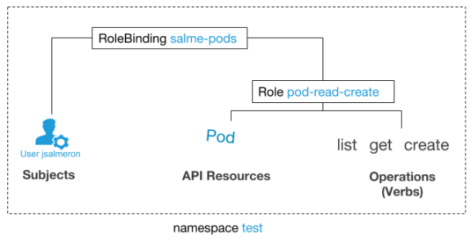
RBAC – RoleBinding to Role

Slide 30
RBAC – Role
kind: Role
apiVersion: rbac.authorization.k8s.io/v1beta1
metadata:
namespace: test
name: pod-reader-create
rules:
- apiGroups: [""] # "" indicates the core API group
resources: ["pods"]
verbs: ["get", “list", “create"]

Slide 31
RBAC – RoleBinding to Role
# This role binding allows " jsalmeron " to read pods in the “test" namespace.
kind: RoleBinding
apiVersion: rbac.authorization.k8s.io/v1beta1
metadata:
name: salme-pods
namespace: test
subjects:
- kind: User
name: jsalmeron
apiGroup: rbac.authorization.k8s.io
roleRef:
kind: Role
name: pod-read-create
apiGroup: rbac.authorization.k8s.io

Slide 32
RBAC – ClusterRole
kind: ClusterRole
apiVersion: rbac.authorization.k8s.io/v1beta1
metadata:
# "namespace“ omitted since ClusterRoles are not namespaced
name: secret-reader
rules:
- apiGroups: [""]
resources: ["secrets"]
verbs: ["get", "watch", "list"]

Slide 33
RBAC – RoleBinding to ClusterRole
# This role binding allows "dave" to read secrets in the "development" namespace.
kind: RoleBinding
apiVersion: rbac.authorization.k8s.io/v1beta1
metadata:
name: read-secrets
namespace: development # This only grants permissions within the "development" namespace.
subjects:
- kind: User
name: dave
apiGroup: rbac.authorization.k8s.io
roleRef:
kind: ClusterRole
name: secret-reader
apiGroup: rbac.authorization.k8s.io

Slide 34
RBAC – ClusterRoleBinding
# This cluster role binding allows anyone in the "manager" group to read secrets in any namespace.
kind: ClusterRoleBinding
apiVersion: rbac.authorization.k8s.io/v1beta1
metadata:
name: read-secrets-global
subjects:
- kind: Group
name: manager
apiGroup: rbac.authorization.k8s.io
roleRef:
kind: ClusterRole
name: secret-reader
apiGroup: rbac.authorization.k8s.io

Slide 35
RBAC – Use Cases
Limit user access to specific namespaces
Limit user permissions relative to their Role
Group users based on their Roles and assign permissions to the group
Pre-assign special hardware nodes to certain user groups and workloads
Segment your continuous deployment pipeline with permissions to deploy in to only specific namespaces

